Slide 1
Decision Making AI using Reinforcement Learning
Self Teaching Neural Network when Answers and Patterns are Unknown
By William Li

Slide 2
Why Reinforcement Learning
Img Source: See Appendix A

Slide 3
Plan of Attack
Create Suitable Environment
Choose Neural Network Layers
NN AI Explores and Learns
Observe Results
Refinement of HyperParameters
NN AI Exploits Environment

Slide 4
Training Overview
Model predicts quality about current state
Model Picks an Action
Model Revaluates new State
Expected? Surprised?
Learn from Observation
Update values for the now ‘previous’ state

Slide 5
Training Overview
Model predicts quality about current state
Model Picks an Action
Model Revaluates new State
Expected? Surprised?
Learn from Observation
Update values for the now ‘previous’ state
AI: “I think the quality scores for this state are:”
[-0.05,-0.01,0.02, 0.5]

Slide 6
Training Overview
Model predicts quality about current state
Model Picks an Action
Model Revaluates new State
Expected? Surprised?
Learn from Observation
Update values for the now ‘previous’ state
AI: “Let’s go with Choice 4, the best move”
[-0.05,-0.01,0.02, 0.5]

Slide 7
Training Overview
Model predicts quality about current state
Model Picks an Action
Model Revaluates new State
Expected? Surprised?
Learn from Observation
Update values for the now ‘previous’ state
AI:”That was a terrible move! Actual score, -0.5”
[-0.05,-0.01,0.02, 0.5]

Slide 8
Training Overview
Model predicts quality about current state
Model Picks an Action
Model Revaluates using New State
Expected? Surprised?
Learn from Observation
Update values for the now ‘previous’ state
AI: “I should have predicted:”
[-0.05,-0.01,0.02, -0.5]

Slide 9
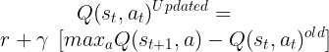
Training Overview
Model predicts quality about current state
Model Picks an Action
Model Revaluates new State
Expected? Surprised?
Learn from Observation
Update values for the now ‘previous’ state
Q-Learning

Slide 10
Key Insight
Proportionate Reward
Deeper Brain
Train backwards from the end (If possible)
More time!

Slide 11
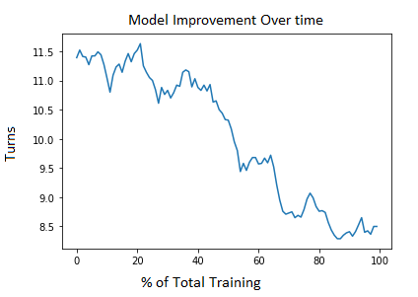
Results

Slide 12
Conclusion and Next Steps
Neural Network Model Learned Game!
Improvements from 11.5 turns with random moves, to 8.5 with learned patterns
What’s Next
More Training
Increase Complexity
Add More States
Introduce Competitive Versus Element

Slide 13
Thank you for Listening Any Questions? Catch me in Session Room After!
See the code at
https://github.com/li-william-wl/ReinforcementLearningAI
Play the Game the AI trained on at
https://bit.ly/3ch2GWA
Appendix Source:
A: https://medium.com/robotic-arm-control-using-deep-reinforcement/robotic-arm-control-using-deep-reinforcement-learning-3443969f7d0f

Slide 14
Game Rules

